Slide 1

Chapters 10-18
By: Jamie McMillan

Slide 2


Slide 3

Lady novelists: women authors of novels. became frequent in the mid 1800s
Harriet Tubman: an escaped slave who helped over 300 other slaves escape in the under ground railroad
women "support system": women who keep the traditional values in their house hold to ease transition for their husbands and children to the new social aspects that were coming about in the 1800's
suffrage: legal right to vote
carding wool: common task that female children where they would prepare the fibers of wool to be made into clothing

Slide 4

The denial of suffrage to white women stemmed from the patriarchal belief the men headed house holds and represented the interests of all household members.
Every wealthy single woman who lived alone were considered subordinate to male relatives and denied the right to vote.
  New jersey was an exception to this rule until it amended its constitution in 1807 to withdraw the franchise from propertied women
Although unable to vote, women of the upper classes had long played important informal roles in national politics.
  Presidents’ wives like Abigail Adams and Dolley Madison were famous for their ability to provide the social settings in which their husbands could quietly conduct political business.
Another unrecognized group of skilled politicians were the women who ran the Washington boardinghouses where most congressmen lived during the legislative term.
  Theses women, long time Washington residents, often served as valuables sources of information and official contacts for their boarders. At the state and local level of politics as well, women-often the wives of politicians- engaged in political activities.
Although the extension of suffrage to all classes of white men seemed to indicate that women had no role in public affairs, in fact women’s informal involvement in politics grew along with the increasing pace of political activity.
  At the same time however, as “manhood” rather than property became the qualification for voting, men began to ignore women’s customary political activity and to regard their participation as inappropriate, an attitude that politically active women increasingly resented

Slide 5

Slave marriages were more equal than white marriages.
  The man was dominant and the woman was dependent and submissive in a white marriage
  In a slave marriage, husband and wife were both powerless within the slave system
Husband and wives cooperated in loving and sheltering their children and teaching them survival skills and above all, continuity.
  Family heritage was taught as much as possible as well as oral traditions
No legal action was taken in the frequent cases of rape, general abuse, and punishment
One of the most common violations of the paternalistic code of behavior was the sexual abuse of female slaves by their masters
It was rare for slave owners to publicly acknowledge fathering slave children, and black women and their families were helpless to protest their treatment.
  Equally silenced was the master’s wife who for reasons of modesty as well as her subordinate position was not supposed to notice either her husband infidelity or his flagrant crossing of the color lines.
Harriet Tubman and the underground railroad

Slide 6

Plantation mistresses spent most of their lives tending family members-including slaves- in illness and in childbirth, and supervising the slaves performances (cooking, cleaning, sewing, weaving, etc)
  Although she did not rule it, that was he husbands job. She only supervised.
In addition, plantation women often had to spend hours, even days, of behind-the-scenes preparation for the crowds of guests she was expected to welcome in her role as elegant and gracious hostess.
A wife who challenged her husband or sought independence from him threatened the entire paternalistic system of control.
  If she was not dependent and obedient, why should slaves be?
Women often became lonely.
  They seldom saw anyone except family
There are a few examples of white women giving genuine sympathy and understanding towards black women.
Both northern and southern women were banned from public life and taught that their proper role was domestic and family based.
In the north, women came clearly to control the domestic “sphere” and to carry domestic concerns outside the family and into a wide range of activities that addressed various social reforms.
Such autonomous behavior was out of the question for plantation mistresses, who were locked by the paternalistic model into positions that bore heavy responsibility but carried no real authority.
These difficulties experienced in some ways privileged women illustrate the way the slave system affected every aspect of the personal life of slave owners.

Slide 7

Women were to teach their daughters to easy tasks (carding wool) at a young age and taught them more difficult tasks (weaving and spinning) as they grew older.
Although women as well as men did task oriented skilled work, the formal apprenticeship system was exclusively for men.
Because it was assumed that women would marry, most people thought all girls needed to learn were domestic skills.
  Women who wanted work however, found a small niche of respectable occupations as domestic servants, laundresses, seamstresses, often in the homes of the wealthy or as cooks in small restaurants. Prostitution was common for an occupation (especially in seaport cities) but not respectable.
Women were under subject to their husbands
Women had no legal rights; a married woman’s property belonged to her husband.
The first factory was filled with orphaned children and women
Women and men made 25% of workforce, but men had the most skilled and best-paid jobs.

Slide 8

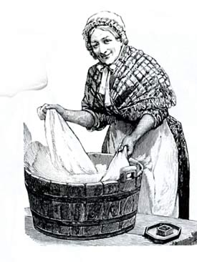
The industrialization of textiles-first spinning then weaving- relieved women of a time consuming job. To supplement the family income, women now had the choice of following textile work into factory or finding other kinds of home work.
1802 birth of the garment industry gave many women a job.
However, many people believed that “respectable” women did not do factory work, and this disparagement fostered low pay and poor working conditions.
The lower the piece of garment rate, the more each woman sewing at home, had to produce to earn enough to live.

Slide 9

Dramatic fall in birth rate during 19th century. goes from 7 children to 4
When birth control effect failed, surgical abortion was common from 1840-1860 until it was banned
Many women wanted to be free of the medical risks and physical debility that too frequent childbearing brought, but they had little chance of achieving the goal until men became equally interested in family limitations
Women's magazines- mother's magazine- Presbyterian church, mother's monthly journal- Baptists: gave advise to women
Mothers continued to be concerned about their children’s character and mortality as well as informal activity- who the child would be hanging out with
Women were trained to be the nurturing silent "support system" that undergirded male success. and women were also expected to ease the tensions of the transition to new middle class behavior by acting as models and monitors of traditional values
To be a lady novelist was a new and rather uncomfortably public occupation for women.
Lady novelists were often driven to novel writing when her fathers lost their fortunes in the panic of 1837. Sedimental novels were a common trend as well relating to the more private and personal lives of women.

Slide 10



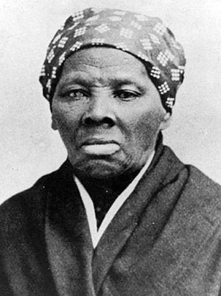
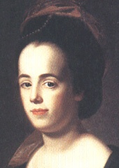

Slide 11

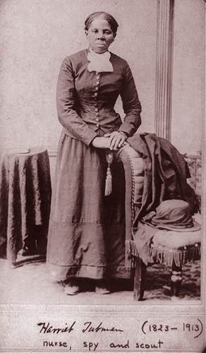
A former slave who, over 10 years, helped over 300 other slaves escape in the under ground railroad

Slide 12

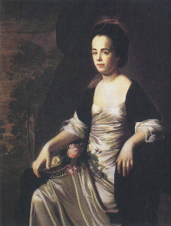
famous writer. One of her most famous pieces is “The Equality of Sexes.” She was an early feminist. She also wrote dramas in addition to essays.

Slide 13



Slide 14




  Increased from 5 to 7
  Increased from 4 to 7
  Decreased from 7 to 4
  Decreased from 7 to 5
  Women
  Children
  Men
  Only i
  i and ii
  i, ii, iii
  ii and iii

Slide 15


  Cooking meals
  Cleaning the masters house
  Raising the master’s children
  All of the above
  Textile industry
  Garment industry
  Quilting industry
  Culinary industry

Slide 16


  25%
  50%
  75%
  100%
  Lack of freedom in relationship
  Father’s loss of fortune
  Lack of freedom in society
  Sick and tired of bearing children

Slide 17


  Senile
  Pale
  Depressed
  Lonely
  Rape
  Beating to death
  Under feeding
  Poor living conditions

Slide 18


  They made more money than men
  A respectable women was thought of not to be able to work
  They produced products faster than men
  If women could work for money, then eventually slaves could too.
  If wives don’t have to obey, slaves don’t either
  If wives seek independence, no man will know how to sustain his household
  If wives seek independence, that could eventually lead to equality
  None of the above

Slide 19


Slide 20

Seneca Falls convention of 1848: first women’s rights convention in American history
Asylum movement: poor treatment of women in asylums brought to attention of public.
Lydia Finney: first president of Female Moral Reform Society
Evangelicalism: stresses the importance of personal conversion and faith for salvation.
Parlor: A room in a private home set apart for the entertainment of visitors. Used for many occasions to discuss political issues.

Slide 21

Male and female immigrants in the early 1800’s formed religious social clubs, lodges, and female auxiliaries.
Few women, except prostitutes, went to the theater which was frequented by men of all social stature.
Black mothers, wives, and daughters were left alone ashore while their husbands went abroad ship. They were to compete with Irishwomen as domestic servants, washerwomen, and seamstresses
Men and women who had been converted to the Evangelical religion assumed personal responsibility for making changes in their own lives.
  They wanted to create the perfect moral and religious community on earth
  Belief in the basic goodness of human nature
  moralistic dogmatism

Slide 22

Women became deeply involved in reform movements through their churches. They also did most of the fund-raising for the home missionary societies that were beginning to send the evangelical message world wide.
Nearly every church had a maternal association, where mothers gathered to discuss ways to raise their children as true Christians.
At home, women began to play the central role in child rearing. Outside the home, women helped spread the new public education pioneered by Horace Mann, secretary of the Massachusetts State Board of Education.
  Uniform curriculum thanks to Horace Mann
In the North and West, more children went to school because there were a growing number of teachers hired to teach them, usually young single women.
The career of public education created the first real career opportunity for women.
Many women argued that women’s moral and nurturing nature ideally suited them to be teachers.
By 1850, women were dominant in primary school teaching, which had become an acceptable occupation for educated young women during the few years between their own schooling and marriage.
Women were paid half as much as male teachers and required community supervision.

Slide 23

founded by the evangelical women in New York in 1834 (first president was Lydia Finney)
Surprising to some because many respectable women were willing to acknowledge the existence of something as disreputable as prostitution.
Even more surprising, was the speed with which the societies realized that prostitution was not so much a moral as an economic issue.
Societies rapidly moved to organize charity and work for poor women and orphans. They also took direct action against the patrons of prostitutes by printing their names in local papers, and they successfully lobbied the New York state legislature for criminal penalties against male clients as well as the women themselves.

Slide 24

organized by Dorothea Dix
1843, Dix horrified the Massachusetts state legislature with the results of her several years of study into the conditions to which insane women were subjected.
She described in detail how women were incarcerated with ordinary criminals. How they were also chained while locked up in cages, closets, stalls, or pens and beaten with rods and lashed into obedience.
Dix’s efforts led to the establishment of a state asylum for the insane in Massachusetts and similar institutions in the state.

Slide 25

American women, without the vote or a role in party politics, found a field of activity in social reform movements. There was hardly a reform movement in which women were not actively involved.
Some women-especially those in the temperance, moral, reform, and abolitionist movements-formed all-female chapters to define an implement their own policies and programs.
  The majority of women did not participate in these activates for they were too busy with housekeeping and child rearing (5 kids was the average)
  A few women-mostly members of the new middle class, who could afford servants-had time and energy to look beyond their immediate tasks.

Slide 26

Sarah and Angelina Grimke, members of a prominent South Carolina slave holding family, rejected slavery out of religious conviction and moved north to join a Society of Friends community near Philadelphia.
In the 1830’s they found themselves drawn into the growing antislavery agitation in the North. Because they knew about slavery 1st hand, they were in great demand as speakers.
At first they only spoke in women parlors, as was considered proper. They eventually spoke at mixed gatherings and became the first female public speakers in America.
1837 Angelina Grimke became the first woman to address a meeting of the Massachusetts state legislature.
Grimke sister were criticized for speaking because they were women.

Slide 27

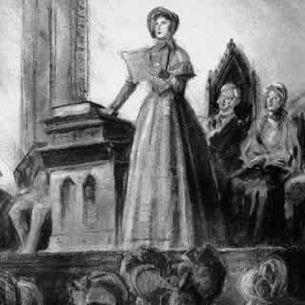
Seneca Falls convention of 1848
  The first women’s rights convention in American history was an outgrowth of almost 20 years of female activity in social reform.
  Every year after 1848 women gathered to hold women’s rights conventions and to work for political, legal, and social equality.
  Altered divorce laws to allow women to retain custody of children and passed property laws more favorable for women.
  Women’s suffrage first proposed
Women gained the voting rights beginning with the Wyoming territory in 1869.
This time challenged popular notion of separate spheres-the public world for him and the home and family for her.

Slide 28



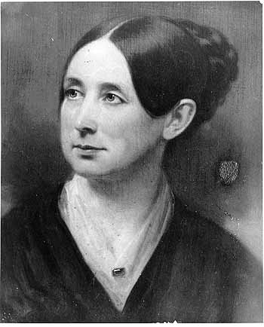
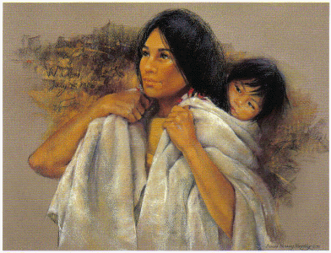

Slide 29

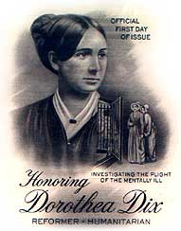
Dorothea Dix horrified the Massachusetts state legislature with the results of her several years of study into the conditions to which insane women were subjected. She described in detail how women were incarcerated with ordinary criminals. Dix’s efforts led to the establishment of a state asylum for the insane in Massachusetts and similar institutions in the state.

Slide 30

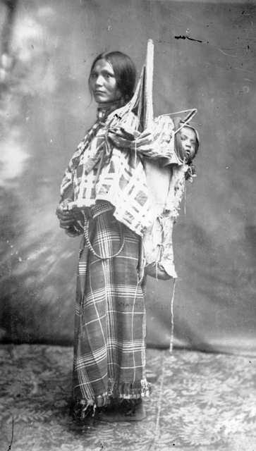
was the only woman who traveled with Lewis and Clark. She an interpreter and guide in their exploration of the Louisiana and the Western part of the United States. At the beginning of the trip, she was 9 months pregnant. She had her baby along the way and raised her child through the expedition.

Slide 31

It’s a lot to remember, but you are half way there!

Slide 32


  Religious social clubs
  Lodges
  Female auxiliaries.
  All of the above
  Men found it unusual for women to have an opinion and wanted to hear their thoughts.
  They had first hand slavery experience.
  They were very skilled at persuading an audience and the north admired that.
  Their father paid parlors to listen and support their ideas.

Slide 33


  3
  4
  5
  7
  Horace Mann
  Lydia Finney
  Dorothea Dix
  Angelina Grimke

Slide 34


  Compromise of 1850
  Missouri compromise
  Seneca falls convention of 1848
  Wyoming territory of 1869
  North and East
  North and West
  South and East
  South and West

Slide 35


  Moral movements
  reform movements
  abolitionist movements
  all of the above were apart of the women’s rights movements
  Horace Mann
  Lydia Finney
  Dorothea Dix
  Angelina Grimke

Slide 36


  1/4 the amount
  1/2 the amount
  The same amount
  Twice the amount
  Political equality
  Social equality
  Legal equality
  All of the above

Slide 37

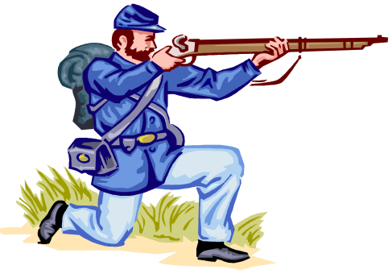

Slide 38

Cowgirls: women who lived on a cattle ranch. Predominately in the West
American Woman Suffrage Association (AWSA): Women’s organization focused on achieving woman suffrage at the state level.
Emancipation: the act of freeing or state of being freed; liberation.
Manifesto: A public declaration of principles, policies, or intentions, especially of a political nature
The Fifteenth Amendment: prohibits government from denying a citizen the right to vote.

Slide 39

Many medical supplies that the armies were unable to provide, were provided by women’s volunteer groups of the South
there was an urgent need for nurses during the civil war
Nursing within a family context was widely considered to be women’s work.
Caring for sick family members was a key domestic responsibility for women, and most had considerable experience with it. But there were strong objections that such work was “unseemly” respectable for women.
Under pressure of war time necessity, and over the objections of most army doctors-who resented the challenge to their authority from people no different than their daughters or wives-women because army nurses.
Hospital nursing previously considered a job only disreputable women would undertake, now became a suitable vocation for middle class women.
Under leadership of Dorthea Dix of the asylum movement and in cooperation with the Sanitary Commission, by the war’s end more than 3,000 northern women had worked as paid army nurses and many more volunteers.
Clara Barton who had been a government clerk before the war and consequently knew a number of influential members of Congress. Barton organized nursing and the distribution of medical supplies; she also used her congressional contacts to force reforms in army medical practice, of which she was very critical.
Southern women were also active in nursing and otherwise aiding soldiers, through the South never boasted a single large-scaled organization like the Sanitary Commission.
As in the North, middle-class women at first faced strong resistance from army doctors and even their own families, who believed that that a field hospital was, “no place for a refined lady.”
Although women had made important advances, most army nurses and medical support staff were men.

Slide 40

By 1869 woman suffragists had split into 2 competing organizations.
  The moderate American Woman Suffrage Association (AWSA), led by Lucy Stone, Julia Ward Howe, and Henry Blackwell, focused on achieving woman suffrage at the state level. It maintained close ties with the Republican Party and the old abolitionist networks, worked for the 15th amendment, and actively sought the support of men.
  The more Radical wing founded the all-female National Woman Suffrage Association (NWSA). For the NSWA, the vote represented only one part of a broad spectrum of goals inherited from the Declaration of Sentiments manifesto adopted at the first women’s right convention held in 1848 at Seneca Falls, New York.
Although women did not vote during this period, they did establish an independent suffrage movement that eventually drew millions of women into political life. The NWSA demonstrated that self-government and democratic participation in the public sphere were crucial for women’s emancipation.
The NWSA’s weekly magazine, Revolution, became a forum for feminist ideas on divorce laws, unequal pay, women’s property rights, and marriage.
The failure of the woman suffrage after the Civil War was led a result of factional fighting than of the larger ideal of expanded citizenship.
The battles over the political status of African Americans proved an important turning point for women as well. The 14th and 15th Amendments, which granted citizenship and the vote to freedmen, both inspired and frustrated women’s rights activists. Many of the women had been long active in the abolitionist movement.
Elizabeth Stanton and Susan B. Anthony, two leaders with long involvement in both the antislavery and feminist movements, objected to the inclusion of the word “male” in the 14th amendment. “If that word ‘male’ be inserted,” Stanton predicted in 1866, “it will take us a century at least to get it out.”
Insisting that the causes of the African American vote and women’s vote were linked, Stanton, Anthony, and Lucy Stone founded the American Equal Right Association in 1866.
The group launched a series of lobbying and petition campaigns to remove racial and sexual restrictions on voting from the state constitutions.
Throughout the nation, the old abolitionists’ organizations and the Republican Party emphasized passage of the 14th and 15th amendments and withdrew funds and support form the cause of woman suffrage. Disagreements over these amendments divided suffragists for decades.

Slide 41

African men play a more direct role than women in fighting for freedom.
Bureau agents designed the husband as household head and established lower wage scales for women laborers. African men asserted themselves by insisting their wives work at home instead of in the fields.
African American editors, preachers, and politicians regularly quoted the biblical injunction that wives submit to their husbands.

Slide 42

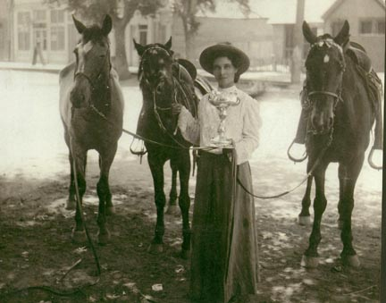
Women who were pregnant and traveling (most commonly west) had to ride side saddle the whole trip.
Although few women worked as trail hands, found jobs in kitchens or laundry. Occasionally a husband and wife worked as partners, sharing even labor of wrangling cattle, and following her husband’s death, a woman might take over altogether.
Majority of women attended to domestic chores.
Prostitution was highly common in cattle towns. 50,000 women engaged in prostitution west of the Mississippi during the second half of the 1800’s.

Slide 43



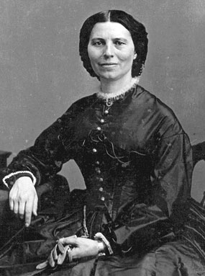
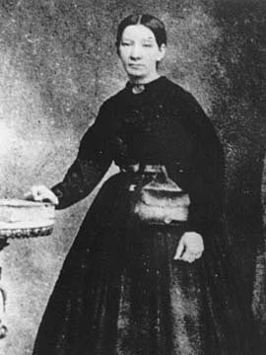

Slide 44

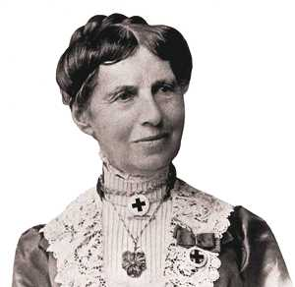
Clara Barton is the founder of the Red Cross. She had been a government clerk before the war and consequently knew a number of influential members of Congress. Barton organized nursing and the distribution of medical supplies; she also used her congressional contacts to force reforms in army medical practice, of which she was very critical.

Slide 45

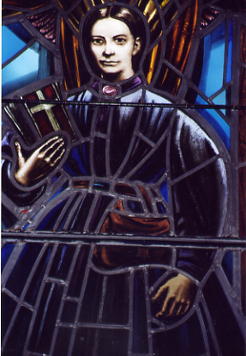
Sally Tompkins established her own private hospital in the south during the civil war. Her hospital treated 1,333 Confederate soldiers from its opening until the last patients were discharged June of 1865. Even though most hospitals had to close because they couldn't get medical supplies from the government, because her hospital had the highest recovery rate, Confederate President Jefferson Davis, let her keep it open.

Slide 46


Slide 47


  women were more likely to spread disease
  women were expected to outshine men in the medical field
  society was concerned with women’s virtues
  men in general made better doctors
  Elizabeth Stanton and Susan Anthony
  Clara Barton and Harriet Tubman
  Julia Stone and Lucy Howe
  Dorthea Dix and Henry Blackwell

Slide 48


  Sharing equal amounts of work with their wife
  Insisting their wives work at home
  Playing a less direct role in wanting freedom than women
  Mainly raising the Children while the wife worked in the field
  Granted right to vote
  Granted right to bear arms
  Granted citizenship rights
  Granted end of slavery

Slide 49


  Lucy Stone
  Julia Ward Howe
  Henry Blackwell
  Harriet Beecher Stowe
  20,000
  40,000
  50,000
  70,000

Slide 50


  Sanitary Commission
  Red Cross
  United White Churches
  Sanitary Control
  Granted right to vote
  Granted right to bear arms
  Granted citizenship rights
  Granted end of slavery

Slide 51


  500
  4,000
  3,000
  7,000
  It served the most soldiers
  It had the highest recovery rate
  She was friends with Jefferson Davis
  To compete with Clara Barton

Slide 52

Text book
  Faragher, J.M., Buhle, M.J., Czitrom, D, & Armitage, S. (2002). Out of many a history of the american people. Upper Saddle River, New Jersey: Prentice Hall.
Dictionary
  The Free Dictionary. (2009). The american heritage® dictionary of the english language. Retrieved January 5, 2011, from http://www.thefreedictionary.com

